Slide 1
A community-driven intelligent language service dapp

Slide 2
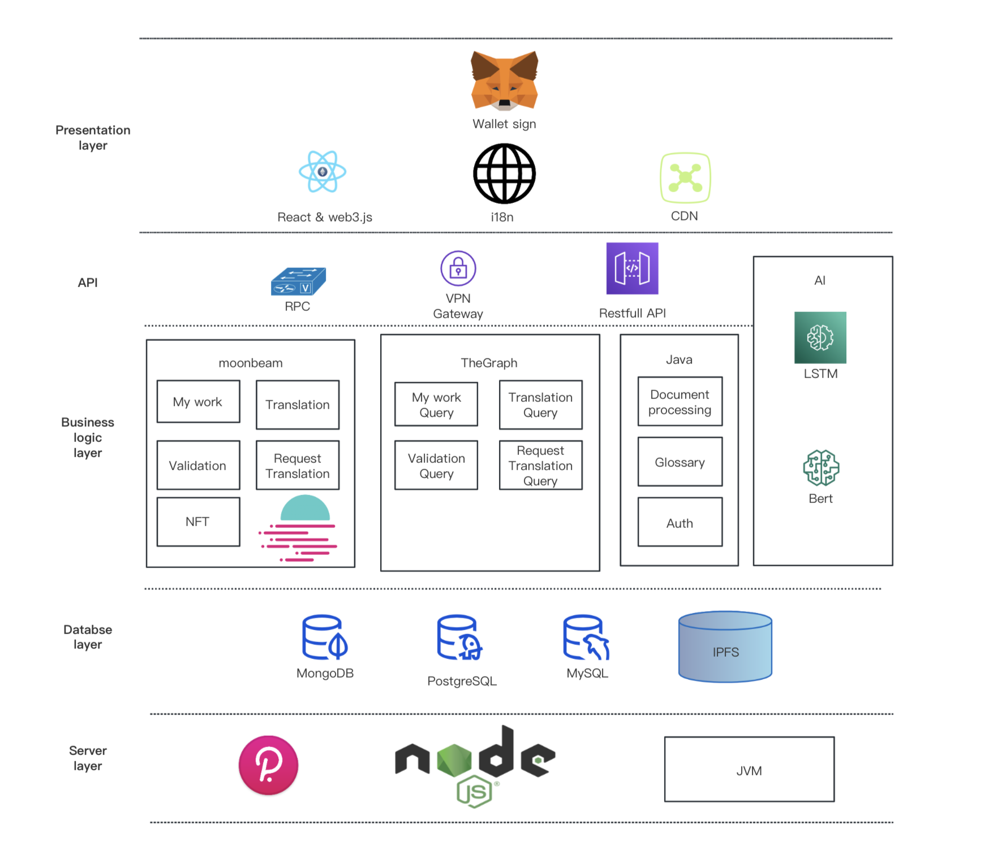
Technology Architecture
Except business is onchain, we also provide opensource translation intelligent tools.

Slide 3
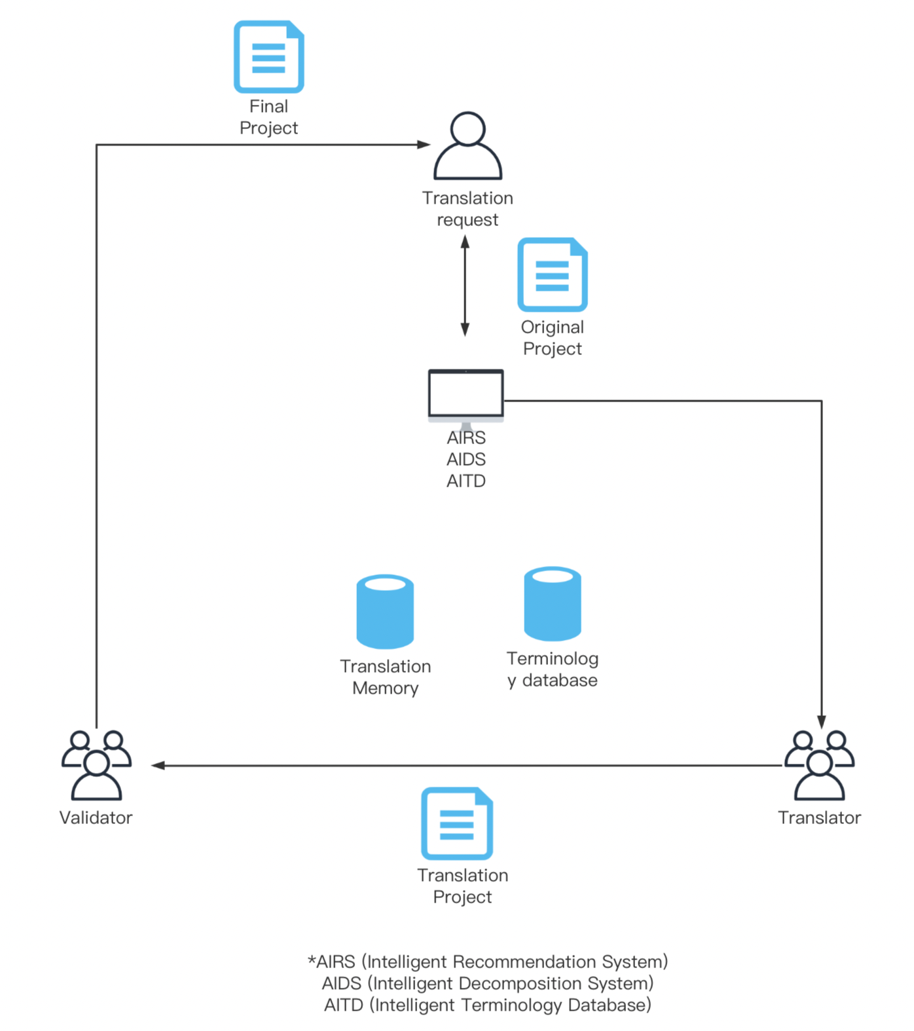
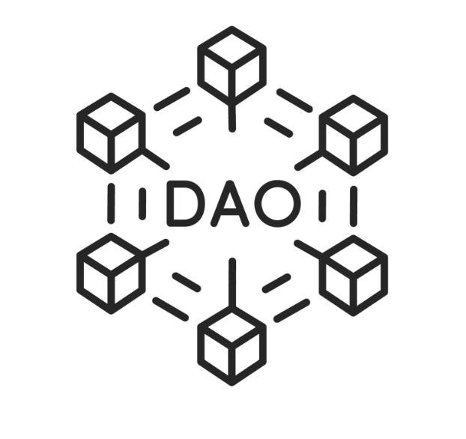
DAO translation group VS Amphi
1. No web3 intelligent translation project in web3
2. Cooperation is maual and slow, tech developing speed is faster than translation
3. Web2 tools are not convenient to use for web3 users
4. Translation asset is offline and can not trade.
1. Amphi provides translation platform for DAOs
2. Processes are coded in smart contract and provide AI tools
3. All procedures are embedded in web3
4. Transferrable translation asset

Slide 4
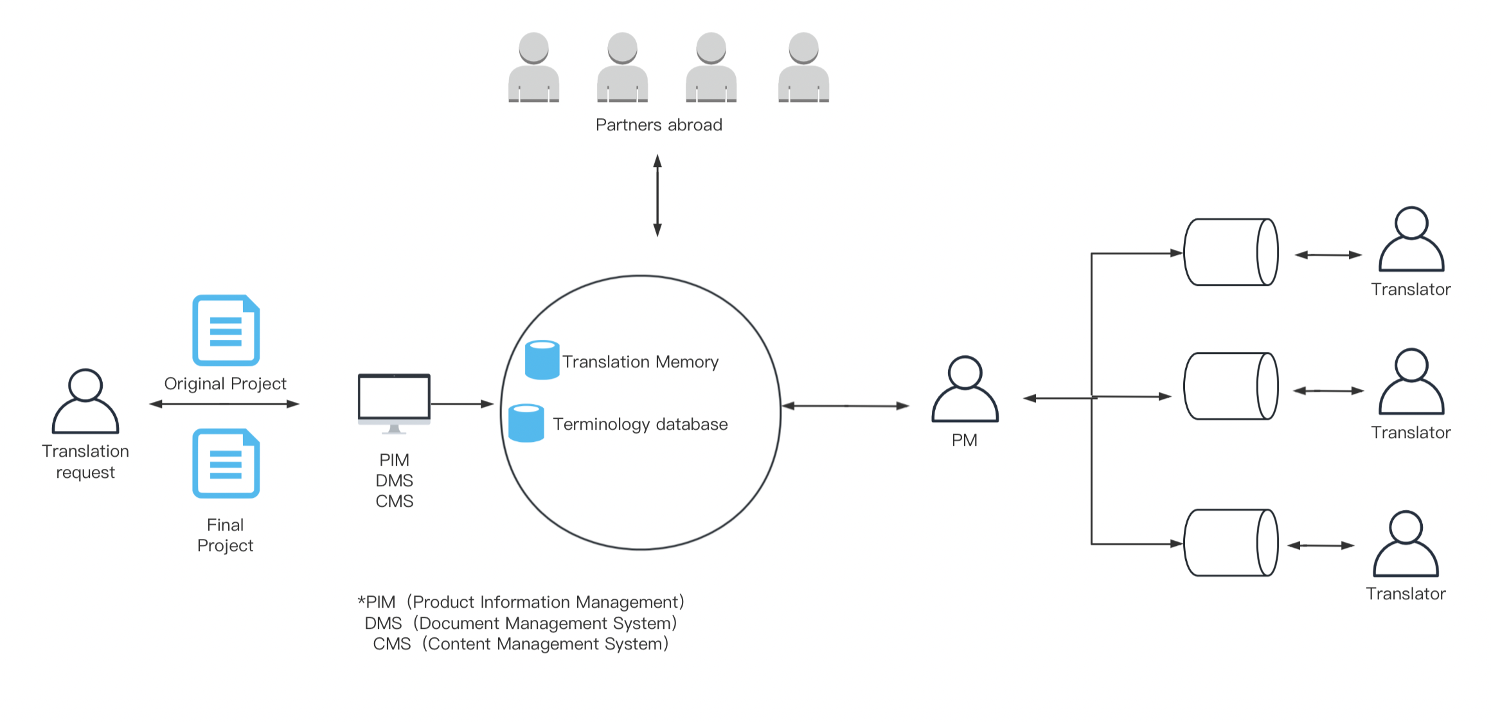
Web2 language service vs Amphi
1. The translator and validator is not only a cooperation relationship like before, the validator has the responsibility to control the translator's quality, and the buyer will control the validator’s quality with a simple choice button accept or reject.
2. Web3 payment is very fast globally, like a minute.
1.The project manager has the power to decide the quality.
2.The centralized transaction always need many processes. Normally it spend 1 month.

Slide 5




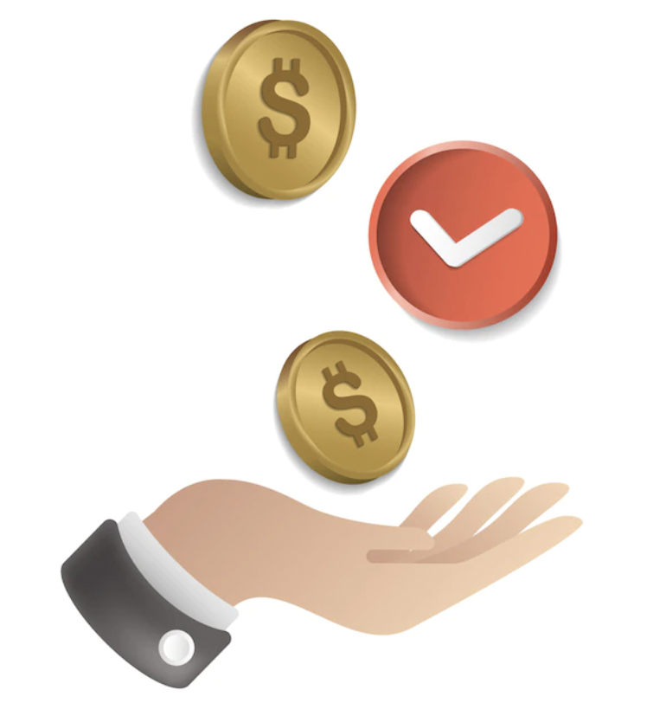
What does Amphi do?
1. More efficient transaction. the translator and validator will feel they can get payment much faster than previous, they get paid month a time once they completed, and now just 1 minute.
2. Flexible cooperation and payment. the bounty can be customized by translation buyer, and workload can be chosen by translators.
3. Increase translators' revenue. the translator and validator will find they can work more than usual and more efficient because of Amphi AI tools
4. High quality service. amphi have tripartite supervision mechanism and DAO to supervise the high quality of translation.
5. Glossary is the asset, and can be mint as NFT. Translators own not only intellectual property but also transferable assets.

Slide 6
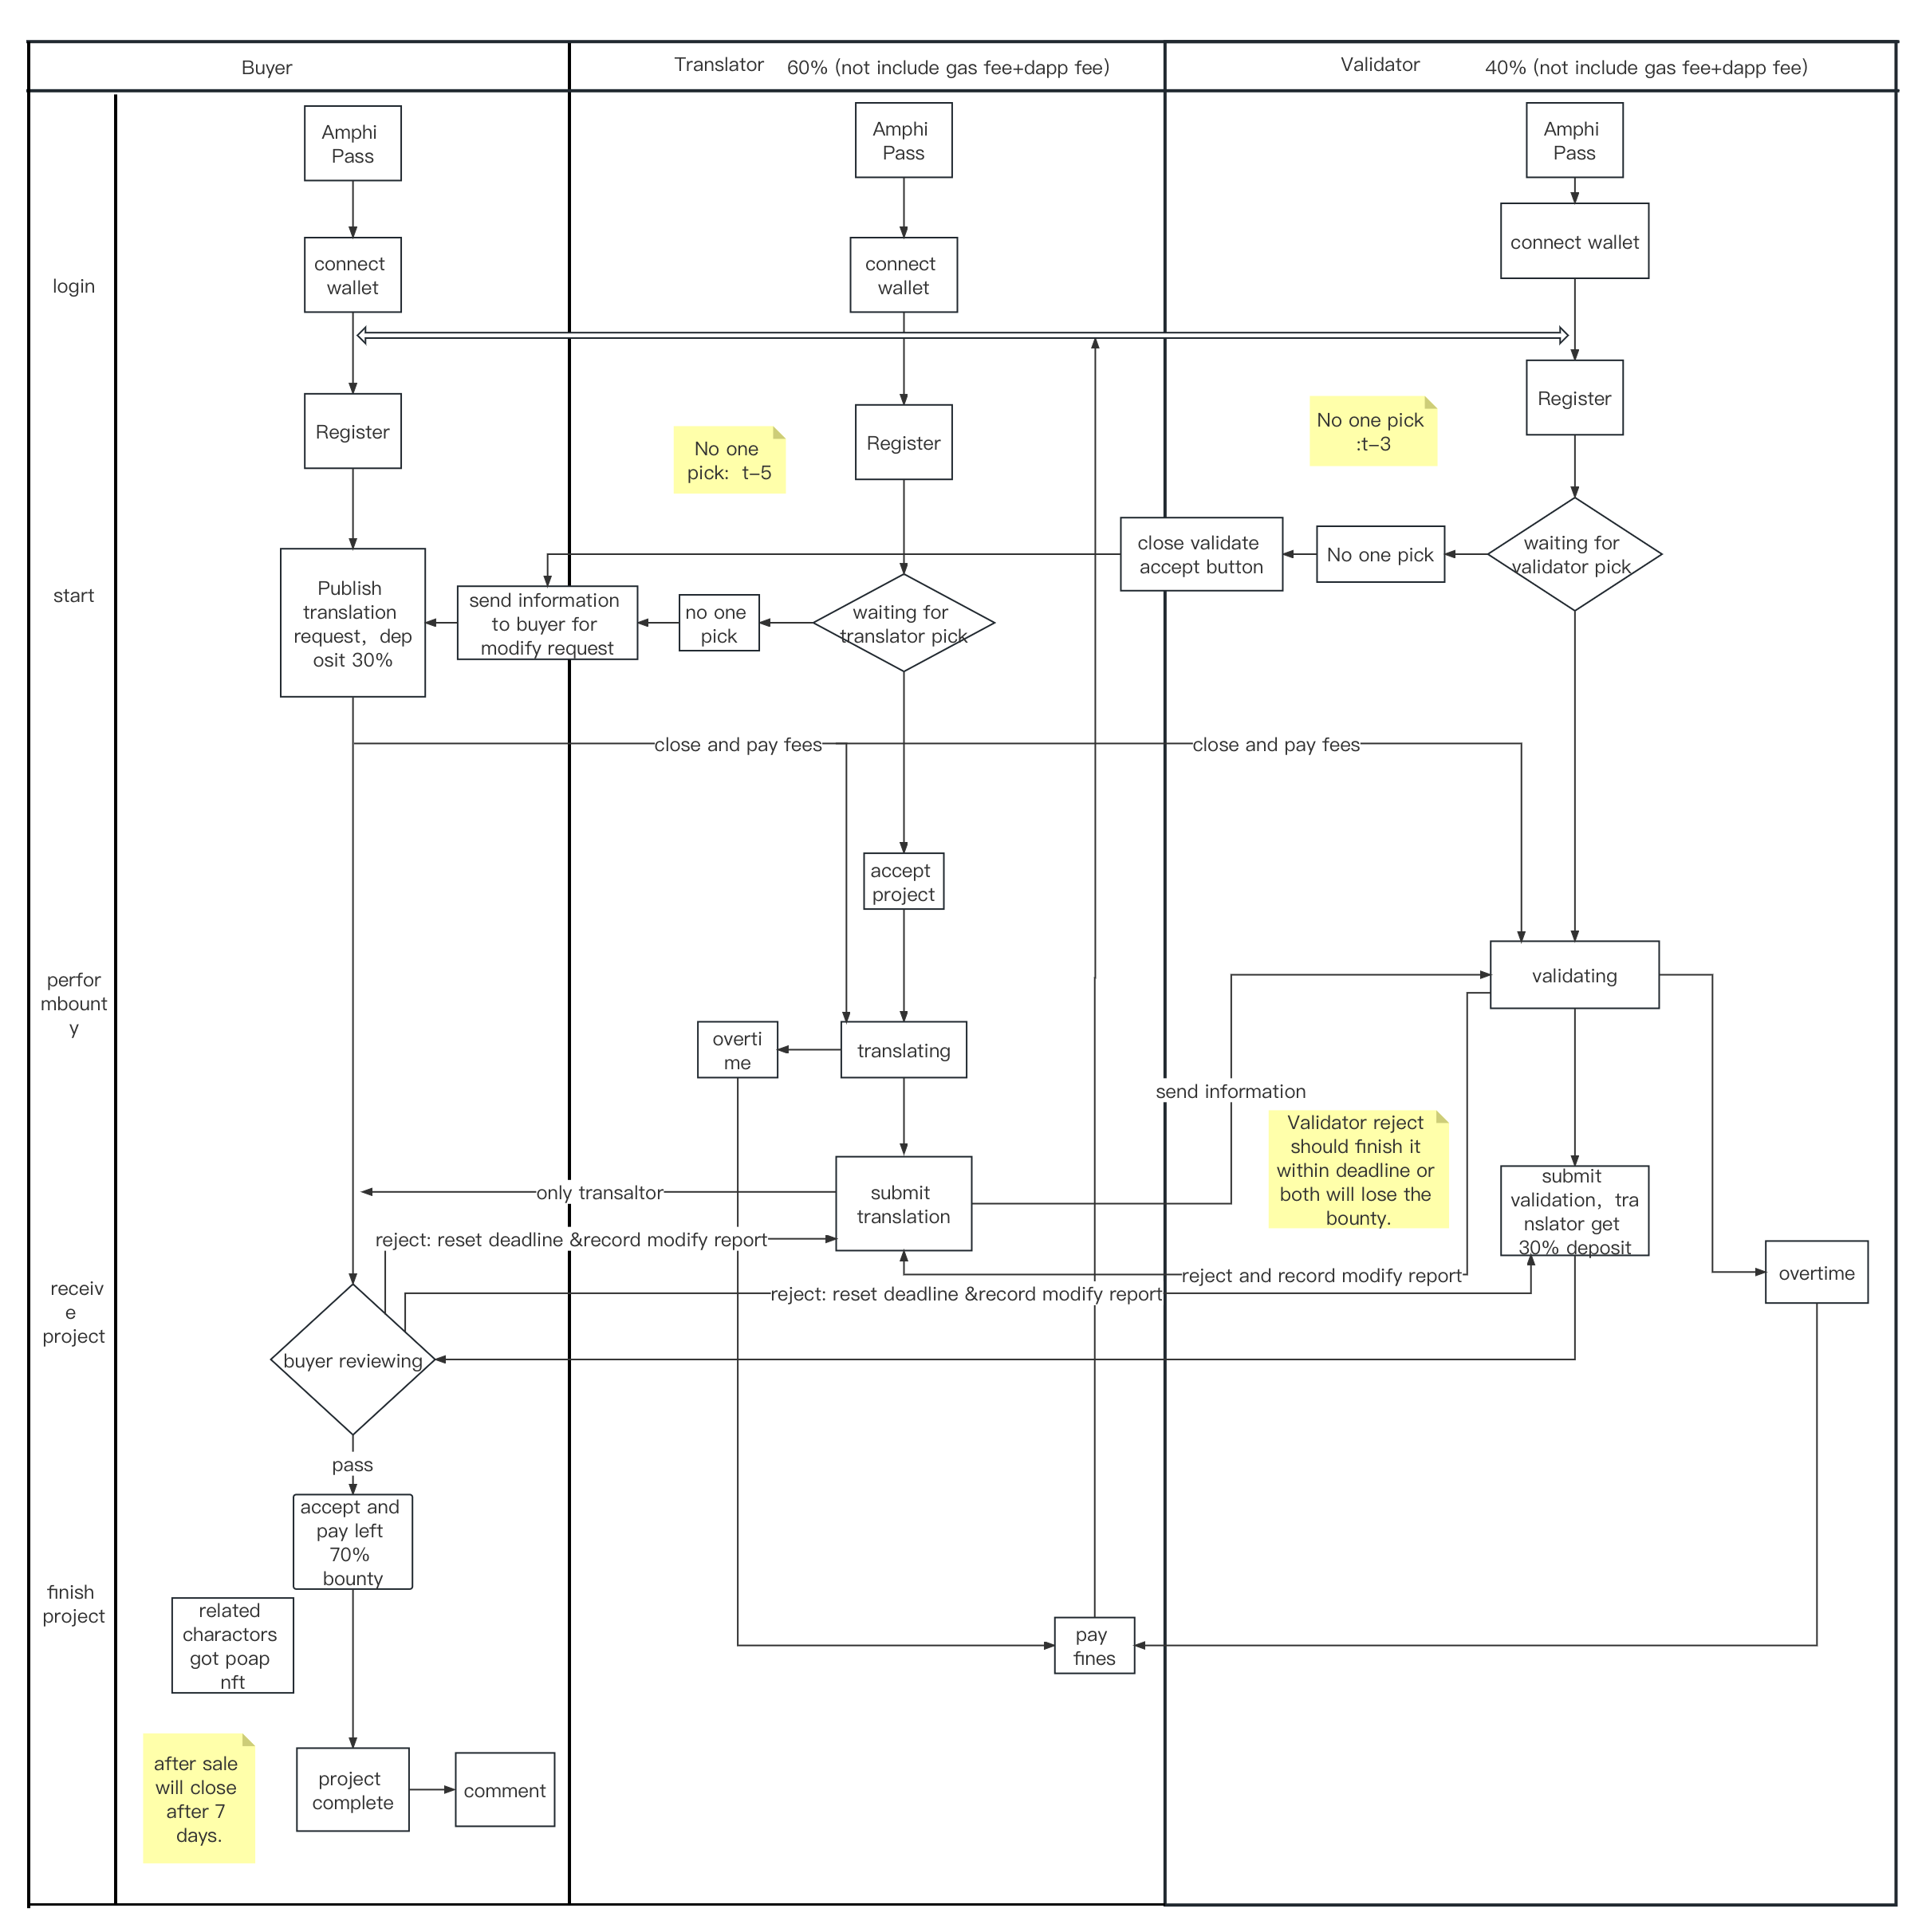
Smart Contract logical
1.Translators are from web2 professional translators, and web3 translation group.
2. Register with certifications.
3. Translators, verifiers, and buyers are mutually restrictive.
4. DAO vote for the quality.

Slide 7
Roadmap
Complete Product
Efficiency
complete business code
complete whitepaper
complete tech papers
complete glossary UI design
complete first vision of community rules
start creation UI design
complete AI glossary database vision1
complete AI translation memory vision1
complete vote function
start decompose task system
DAO start to set rules
2022.12
2023.7
2023.12
Start MVP
2023.3
Communication
2023.10
Next
Amphi DAO start
Amphi UI Design
Amphi NFT Development
Amphi dapp MVP development
complete glossary database vision1
Iterate user experience
Iterate community rules
mint second batch of NFT
start develop AI translation memory
start vote function
DAO operation by itself
complete decompose task system vision 1
complete API to cooperate with other projects
start provide language service in metaverse
iterate project experience
DAO start to build meatverse

Slide 8
Team member
Name | Position | Advantage
Kim | Product | Kim learned about blockchain during her master's degree at Chulalongkorn University and has 10 years of experience in the language service industry. She is good at starting from scratch. She worked in a top Fortune 500 company and kim once built a translation platform to handle tens of millions of translations, and formed a multilingual online team of 83 people. She won the "Best Popunlarity Award" in the Vland Metaverse Global Commercialization Competition.
Why | AI engineer | Why graduated from Chulalongkorn University, Why has published papers in IEEE and has extensive experience in the field of artificial intelligence he won the “Best Popularity Award” in the vland Metaverse Global Commercialization Competition.
Jacky | Front-end engineer | Jacky has 13 years experience in a Fortune 500 company and he is good at task management system development, additionally, he developed a dao project before.
Rui | Scene designer | Rui graduate from RMIT University Melbourne City Campus, good at 3D modeling design and has rich experience in metaverse design
Amo | UI designer | Amo study design majors both undergraduate and master degree, she has a strong understanding ability and a sense of responsibility, and Amo is a good ui designer.
Benio | NFT designer | Benio started to draw pictures since a child and he always get No.1 in art class, he has a variety of design skills and designed a virtual idol.
Jack | NFT contract | Jack developed multiple web3 projects and one of them was successfully acquired.
下次一定早睡 | Smart contract engineer | 下次一定早睡 is an excellent senior who has participated in multiple contract code competitions and has more experience than some solidity developers.
黑鹳 | Back-end | He has rich experience in web3 developement, familiar with rust and java has developed chains, wallets and nft platforms.
尹乐 | Testing | He worked in a wallet company and joined the blockchain for 4 years. He has rich trading experience.
Scott | Front-end engineer | Scott has 10-year work experience in front-end and join in crypto 5 years ago, with multiple web3 project experience, has developed uniswap and decentralized exchanges.
Sometimes | Front-end engineer | Sometimes has 6 years experience in front-end develop, he is good at react .

Slide 9

Thanks for listening！
Let us watch Demo
Twitter: @globalkoon
Website: https://www.amphi.space

